Slide 1


100% Renewable Energy by 2050
Presentation to the District of Sooke
Committee of the Whole
Marion Pape, BCSEA Victoria Chapter and Jeff Bateman, Transition Sooke
November 6, 2017
Notes:
Good Evening Mayor Tait, My name is Marion Pape, I am Past President of the BC Sustainable Energy Association and on the 100% RE Team

Slide 2
Sooke Legislative Context
District of Sooke signed the British Columbia Climate Action Charter in 2008. <clip> “Governments urgently need to implement effective measures to reduce GHG emissions and anticipate and prepare for climate change impacts.”
Climate change highlighted in Sooke’s 2010 Official Community Plan. <clip> “Establish the importance of energy to all aspects of the community’s social, economic and environmental well-being … demonstrate leadership in sustainable energy.”
Sooke Climate Energy & Emissions Plan approved by council in Oct. 2014. Council priorities: i) Promotion of home retrofits & demand-side management programs; ii) Improved walking infrastructure; iii) Organics diversion from Hartland; iv) Urban containment

Slide 3
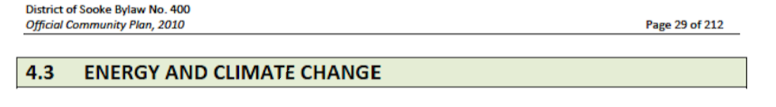
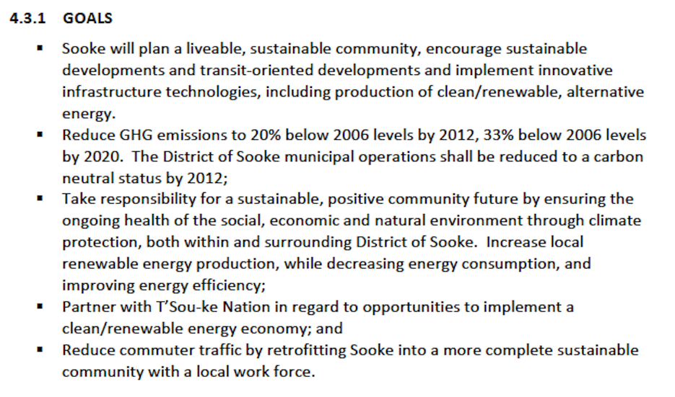
Bylaw #400: OCP 2010

Slide 4
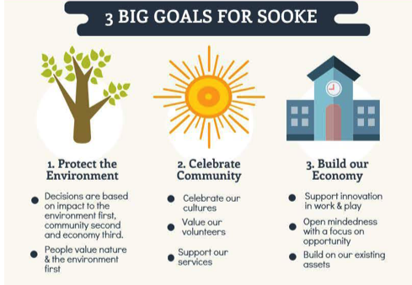
OCP Refresh 2016/17

Slide 5
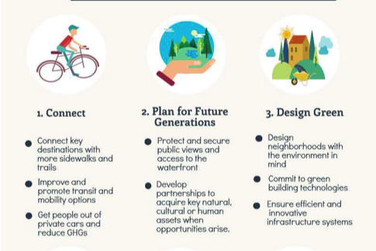
OCP Refresh

Slide 6
Funding Opportunities
Federal/Provincial: Pan-Canadian Framework on Clean Growth & Climate Change, Dec. 9, 2016. Announcement from Ottawa of $2 billion Low Carbon Economy Fund last July; available to all levels of government, indigenous governments, NGOs and private business through 2022.
Federation of Canadian Municipalities’ Green Municipal Fund. $675 million available to Canadian municipalities for “plans, feasibility studies, pilot projects and capital projects” that “improve air, water and soil, and reduce GHG emissions.”
DOS Carbon Tax Rebate Reserve Fund (currently $6k approx. “to support initiatives to reduce carbon emissions in the District of Sooke”).

Slide 7
Greening Sooke: Highlights
T’Sou-ke First Nation: International renown for ‘Solar City’ (one of just five in Canada named by the Canadian Solar Cities Project)
T’Sou-ke Centre for Sustainability – skills training in the creation of energy efficient housing for indigenous communities in BC
DOS achieves carbon-neutral municipal operations in 2015, earning Level 3 (highest possible) recognition from the Union of BC Municipalities.
Geothermal heat pumps in select homes at Woodland Creek; Built Green Canada Gold standard met by Harbourside Cohousing
Green residential builders in Sooke – Keary Conwright, Frank McKendry, Forest Adam, Tony Johnston, Paul Clarkston, David Dare, among others.

Slide 8
Greening Sooke … (2 of 2)
Youth for Change students fundraise for EV station at EMCS, 2016/17; DOS planning fast-charge EV station(s) slated for Evergreen Mall, early 2018
Tidal power: Accumulated Ocean Energy (in collaboration with T’Sou-ke Nation) + new Sooke start-up Go With the Flow Technologies
Solar installation: Viridian Energy Co-Operative, Endless Energy & Solar Solutions, independent contractors
T’Sou-ke Nation, Timberwest and EDP Renewables Canada announce intention (2013) for $750-million in large-scale wind power projects on Vancouver Island
Roadside clean-up: Sifu Moonfist + tradition of litter-busting with Rotary Club, EMCS Youth Engagement Team, Zero Waste Sooke & other community groups
Transition Sooke citizens’ initiative, 2010 to present

Slide 9
Climate Change Action Committee
2015/16 discussions
District to remain focused on CEEP priorities as determined by council.
Primetime for DOS to seek project and infrastructure grants from the provincial and federal governments.
Expand boundaries of Solar City to the DOS through collaboration with the T’Sou-ke Nation, SD #62, local business. Examples: Solar arrays at the Municipal Hall and EMCS; or a community solar project (solar farm, solar parking lot, biomass heating system).
DOS to investigate a municipal compost facility and yard-waste depot. [Council awaiting CRD decision on regional compost facility]
Committee of the Whole to consider participating in the BC Sustainable Energy Association’s “100 Percent Renewable Energy By 2050” campaign for CRD municipalities.

Slide 10

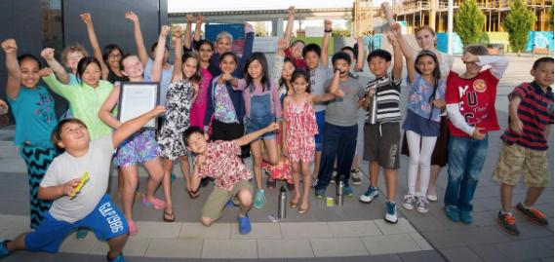
Notes:
My speciality is in developing networks, engaging communities and building large movements. I am working with GVAT and CIC to bring the large environmental issues of the day to the table and work with faith groups, labour unions, CBO’s and Environmenatla groups
Founded in 2004, 500 members and 5 chapters across BC working to educate and empower British Columbians on sustainable energy transition
Cool It! Climate Leadership Training offers workshops in grades 4 to 7.
BCSEA brings energy issues forward to govt, business and communities.
BCSEA intervenes in Utilities Commission reviews of the energy plans of BC Hydro and other utilities.
This presentation tonight is a part of our work in empowering communities

Slide 11
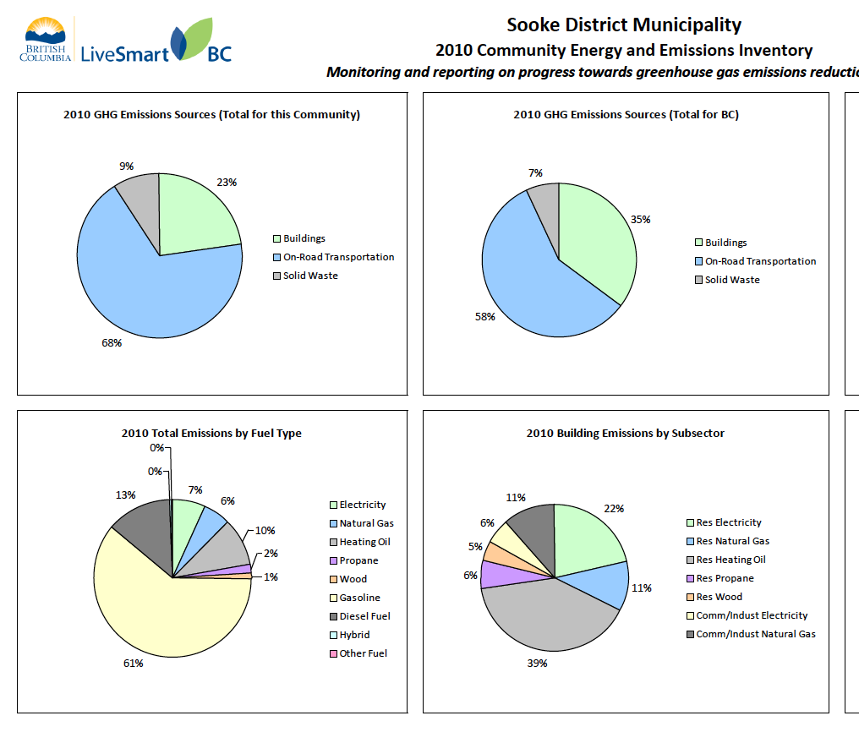
Notes:
One starts with the data on energy use and emissions and some things Sooke can work on
Buildings an obvious start: Heat pumps means replacing fossil fuel heating and with heat pumps. (Building efficiency upgrades considered to be most important by some. Others say fuel switching to heat pumps are more important.)
Densification means zoning for multi-unit residential development and walkable communities.
Transportation especially relevant for Sooke: The 2050 100% RE vision goes further, with mode shifting – switching from personal vehicles to electrified transit, cycling and walking. Assume that freight transportationand buses will be electrified and will be planned and managed to reduce the number and length of trips.

Slide 12
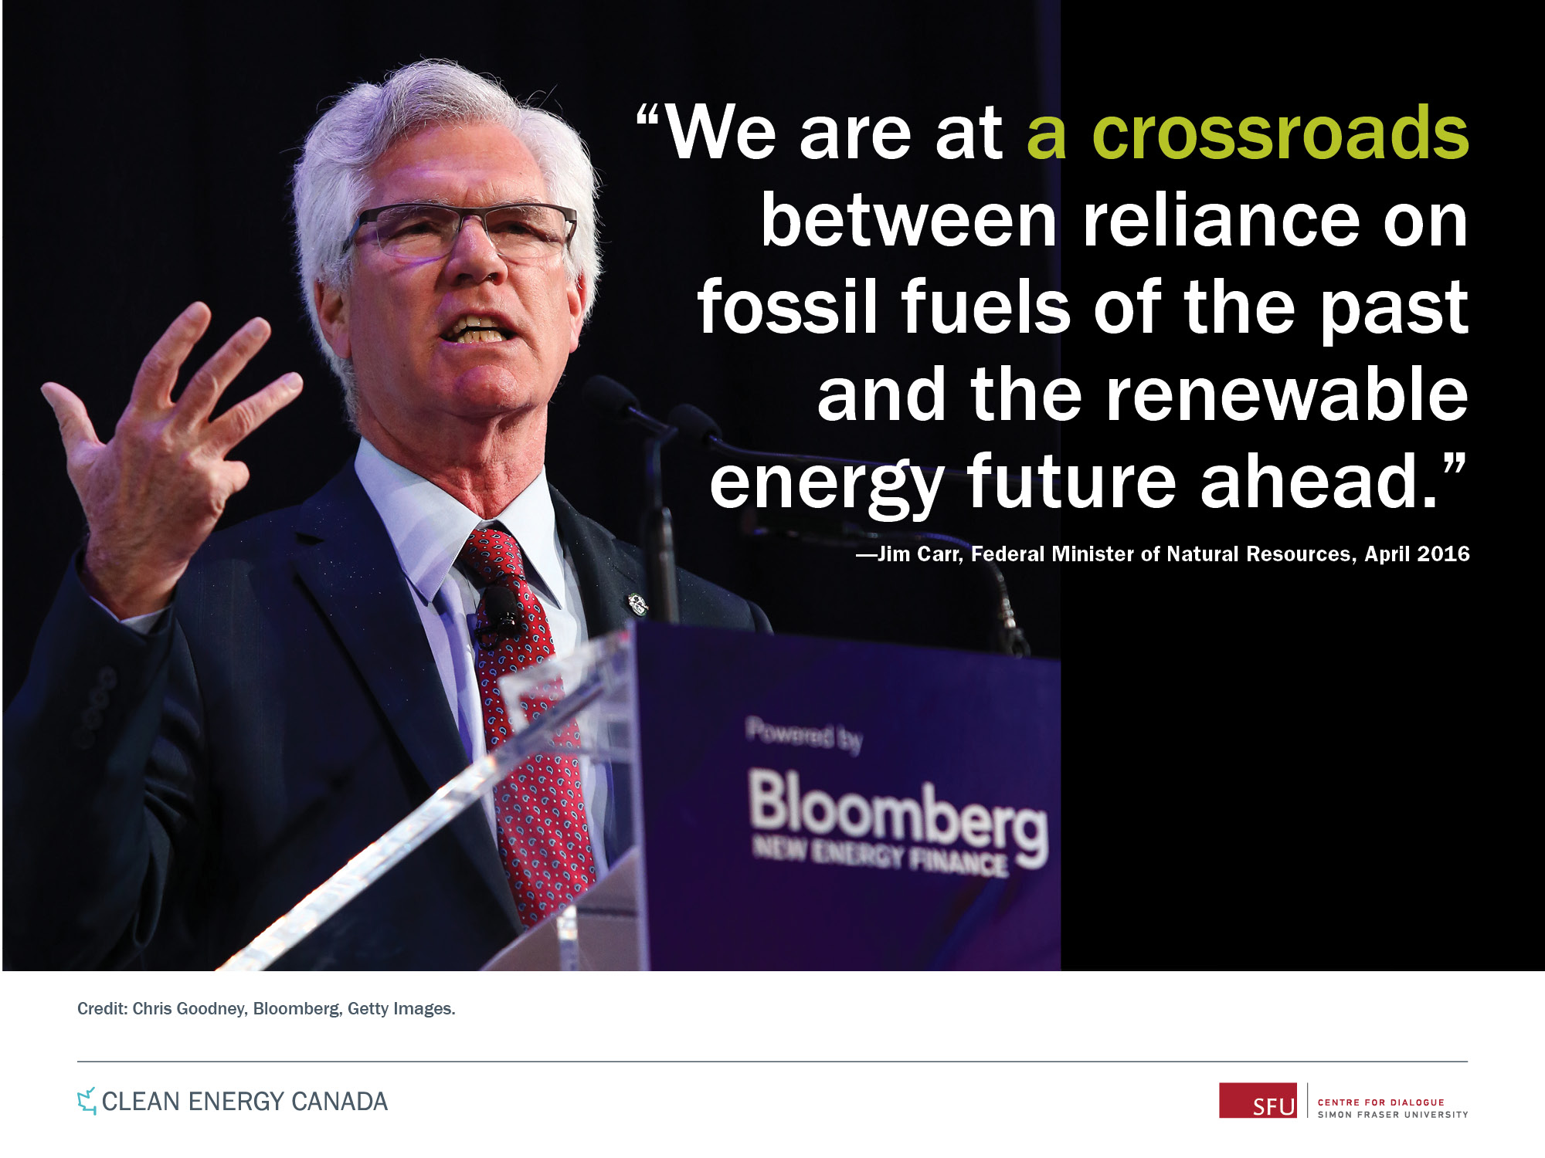
CROSSROADS in time

Slide 13
COP 23 Bonn, Germany, Nov. 2017
“We know that, as climate change intensifies, the ability of the land and oceans to mop up our carbon emissions will weaken…
There’s still time to steer these emissions down and so keep some control….
But if we wait too long humankind will become a passenger on a one way street to dangerous climate change.”
            Dave Reay, University of Edinburgh, Guardian
Notes:
COP23 in Bonn, Germany this week. Annual Bulletin just released, revealed that in 2016, the average global concentration of CO2 emissions surged at a record-breaking pace to the highest level in approx 3 million years.
David Reay, a professor of carbon management at University of Edinburgh not involved in the research, told the Guardian:

Slide 14

100% Renewable Energy by 2050
Notes:
During the 2015 UN Climate Conference, 1,000 mayors announced major commitments to reduce carbon pollution or switch to renewable energy.

Slide 15
What is 100% Renewable Energy by 2050?
100% RE goal means: “Transition to 100% renewable energy sources in all three energy use sectors (electricity, heating/cooling and transportation), community wide by 2050 towards an equitable, sustainable future.” From Renewable Cities (SFU)
This transition would be made through collaborative, democratic engagement with stakeholders, partners and communities. It would be tied to energy democracy and social justice, and would seek aggressive energy reductions through conservation and efficiencies.
Notes:
With our 100% Renewable Energy by 2050 initiative, BCSEA is explaining and advocating for this target to all municipalities in the capital region.
This definition comes from the Renewable Cities initiative at SFU and is the one we are using

Slide 16
Greater Victoria Region a 100% RE Region
BCSEA Victoria Chapter is working with municipal governments across the region to declare themselves 100% RE Municipalities
  August 2016 Victoria Declaration
  March 2017 Presentation to Saanich of Pathway Report
  October, 2017 Saanich Declaration
  Presentation was made to Esquimalt
  Nov. 6 presentation to Sooke
  Metchosin later in Nov.
  Discussions with Central Saanich, Oak Bay and others
Notes:
This is a growing vision around the world.
Vancouver adopted this target in 2015
Saanich worked with Victoria and Saanich: produced a Pathway to 100%Renewable Energy for Saanich and worked with them to engage the community eg Big Town Hall, collecting signatures at local fairs and events, making multiple presentations to Council from citizens across the municipality-
The District of Saanich passed a motion to work towards 100% RE at a Council Meeting in October 2.
Esquimalt received a presentation
Sooke is next.
Then perhaps over to Central Saanich.
This is hard work… Can we work together on the big questions of transportation, sewage, water

Slide 17
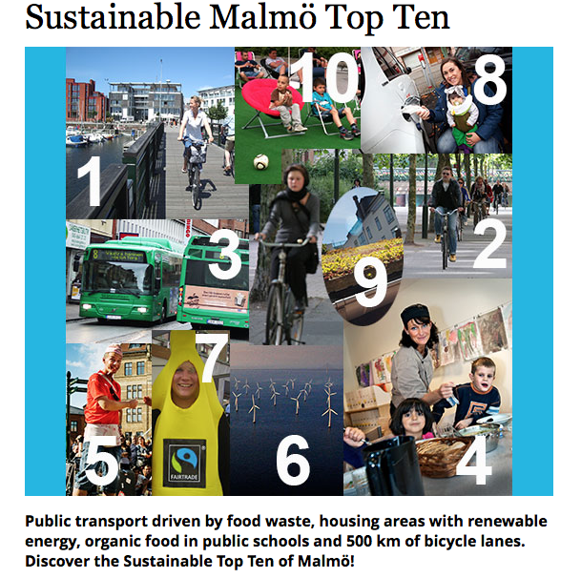
Notes:
Here is an example of a 100% RE Community in Malmo, Sweden which has committed to achieving 100% RE for all energy uses by 2030.
Let’s change Malmo to Sooke for ideas not particularly prioritized..
Buildings: Every new building you construct will last for 50 years minimum and so it behooves us now to think about how to build them to last and be energy efficient. BC has the STEP CODE and Leadership at the Provincial Level. The BC STEP CODE is up for a national award. It is within Sooke’s purview to vote STEP 3 as the standard for buildings. The highest standard that does not cost a lot. Our children and grandchildren will salute you for your compassionate and visionary stance.
2. Every public building has solar PV, the new Library in Sooke with solar. Check out the Salt Spring Public Library
3. Every 4th journey is made using a bike Cycle, walk, public transportation-
4. Organics diversion from heartland landfill stop sending organic scraps to Heartland. Capture the methane
5. Free organic and climate smart school dinners for all children
6. Events on Sooke to provide, not consume energy eg festivals, culture and sports events (food is organic, waste all recycled, public transport available,
7. Actively support Sooke’s many shops with organic and ethically labelled products, Perhaps a “Buy Sooke” promotion?
8. Windpower and a solar farm in Sooke provides electricity to 5,000 households support local initiatives in this area,
9. Many families in Sooke choose to share a car Reduced congestion, less noise and emissions, improved air quality
10. Incentives to install green roofs that stop flooding.

Slide 18
Sustainable Sooke
Buildings: Build them to last and be energy efficient. Set an ambitious level for all new Sooke buildings to a Level 2 or preferably 3 level.
Every public building has solar PV
Every 4th journey is made using a bike, walking or public transportation
4. Organics diversion from heartland landfill stop sending organic scraps to Heartland. Capture the methane
5. Promote free organic and climate smart school dinners for all children
Notes:
1. Every new building you construct will last for 50 years minimum. BC has the STEP CODE and Leadership at the Provincial Level. It is within Sooke’s purview to vote STEP 3 as the standard for buildings. The highest standard that does not cost a lot. Our children and grandchildren will salute you for your compassionate and visionary stance
2. the new Library in Sooke with solar. Check out the Salt Spring Public Library
4. stop sending organic scraps to Heartland. Capture the methane

Slide 19
Sustainable Sooke (cont’d)
6. Provide, not consume, energy at Sooke events, e.g. festivals, cultural and sports events
7. Promote “Buy Sooke”
8. Support windpower and a solar farm in Sooke
9.Encourage Sooke families to car and ride share
10. Develop a set of incentives to install green roofs
Notes:
6. Food is organic, waste all recycled, public transport available,
Actively support Sooke’s many shops with organic and ethically labelled products,
Provides electricity to 5,000 households support local initiatives in this area,
Reduced congestion, less noise and emissions, improved air quality
Green roofs that stop flooding … among many other benefits

Slide 20
Sooke: Next Steps (101 Level)
Council pass a resolution and vision statement re: 100% Renewable Energy in Sooke by 2050 (or sooner).
Sponsor a “Big Town Hall” public event to engage citizens and gather ideas as well as enthusiasm.
Undertake first actions outlined in the BC Energy Step Code’s “best practices guide for local governments”
Minimize zoning and permitting costs for renewable energy systems
Notes:
Thought I would suggest ways of going forward with the easy, medium and then longer range targets-101, 201 and 301 context. Again, these are sample ideas to consider to show you that it will be easier to accomplish when you undertake a few key projects and one at a time.
The big decision is on deciding to do it and establishing a plan as Saanich and Victoria are starting to do.
Gather community input. On behalf of the District of Saanich, the BCSEA hosted such an event a year ago in kickstarting the ”pathway process” that Saanich has approved and is now enacting.

Slide 21
Sooke: Next Steps (201 Level)
Identify a major infrastructure project, create a shovel-ready blueprint and seek funds from the province, independent grant organizations and the FCM’s Green Municipal Fund.
Put solar on every public building and continue to maximize energy efficiency of existing and future public buildings
Require minimum energy efficiency investment as part of affordable housing and rental licensing
Notes:
Solar at EMCS would allow trades students to prepare for jobs in tomorrow’s “green economy”

Slide 22
Sooke: Next Steps (301 Level)
Study the cost-effectiveness of inclusive financing for on-site energy financing and renewable energy
Create a community renewable energy policy that allows electric customers to collectively own and share energy from a renewable energy project
Commit to developing local renewable energy production to serve local needs, i.e. a solar farm
Notes:
These re ones that we would work in partnership to accomplish

Slide 23


QUESTIONS?

