Slide 1

Image credit: Matt Jiggins via Flickr
Learn – Discuss – Imagine – Design – Create

Slide 2
An Introduction to Conversations for a One Planet Region
January 2021
Dr. Trevor Hancock
President, Conversations for a One Planet Region

Slide 3
Territory acknowledgement
We acknowledge with respect the Lekwungen peoples on whose traditional territory we meet and the Songhees, Esquimalt and WSÁNEĆ peoples whose historical relationships with the land continue to this day.

Slide 4
Origins
The Conversations began in early 2017 as a series of public discussions in the lead up to a UVic IdeaFest event in March 2017.
The IdeaFest event was organised by UVic in the Anthropocene, a new group at UVic dedicated to addressing the challenge of the Anthropocene
The interest was so great that we have continued ever since.

Slide 5
The COPR Society
We became an incorporated society under the Societies’ Act of BC in late 2019
Board members
Trevor Hancock, President
Allen McLash, Vice-President
Clare Attwell, Treasurer
Jasmindra Jawanda, Secretary

Slide 6
Vision and mission
Vision
The Greater Victoria Region achieves social and ecological sustainability, with a high quality of life and a long life in good health for all its citizens, while reducing its ecological footprint to be equivalent to one planet’s worth of bio-capacity.
Mission
The Mission of The Conversations is to establish and maintain community-wide conversations on One Planet living and a One Planet Region.
https://oneplanetconversations.ca/

Slide 7
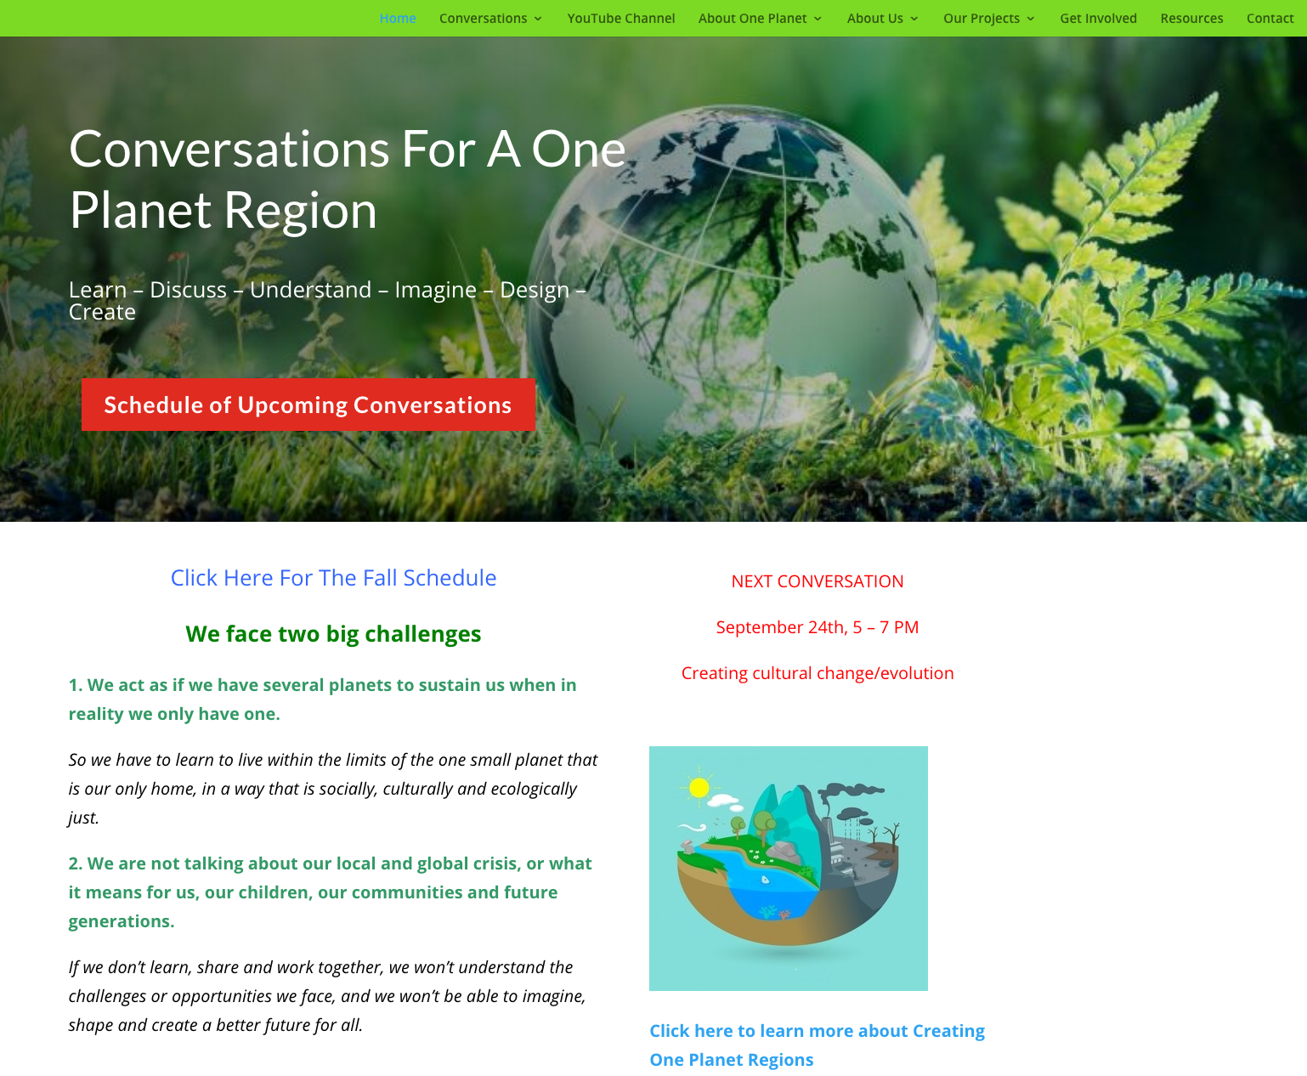
Our website
UNDER CONSTRUCTION
https://oneplanetconversations.ca

Slide 8
1. The basic problem –
More than one Earth

Slide 9
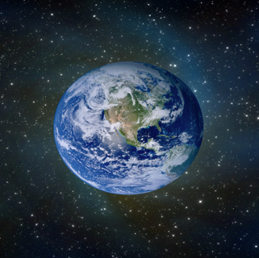
We behave in this region as if we have all this . . .
4 planets
test
test
test
test

Slide 10
. . . but this is what we actually have

Slide 11
We are using much more than our fair share of the Earth’s biocapacity and resources

Slide 12
The greatest challenge we face in the 21st century
How do we live equitably, in harmony and in good health on this one small planet we call home?

Slide 13
To get to a One Planet Region
– our fair share of the Earth - means a
70% reduction in our ecological footprint

Slide 14
One Planet Saanich
One Planet Saanich is a separate but related project.
It began in 2018, when Saanich was approached by the UK-based Bioregional and One Earth in Vancouver to join a small international ‘One Planet Cities’ project.
It is endorsed and supported by the District of Saanich
https://www.oneplanetsaanich.org/

Slide 15
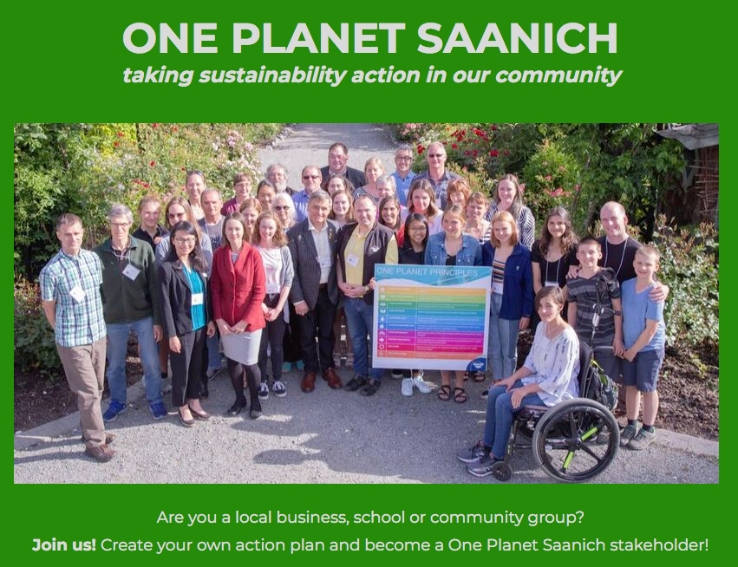

Slide 16
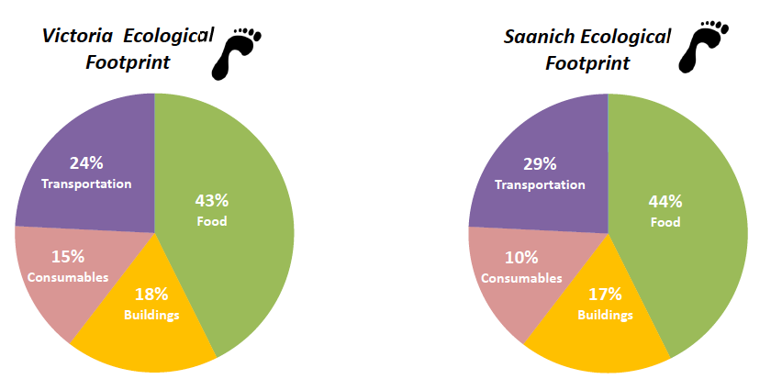
Local ecological footprint = 3 + planets
Source: Moore and Hallsworth, BCIT, 2018
Notes:
Source: ecoCity Footprint Tool
Victoria & Saanich Pilot Testing Results
One Planet Conversations
April 12th, 2018
Presented by:
Dr. Jennie Moore
Cora Hallsworth

Slide 17
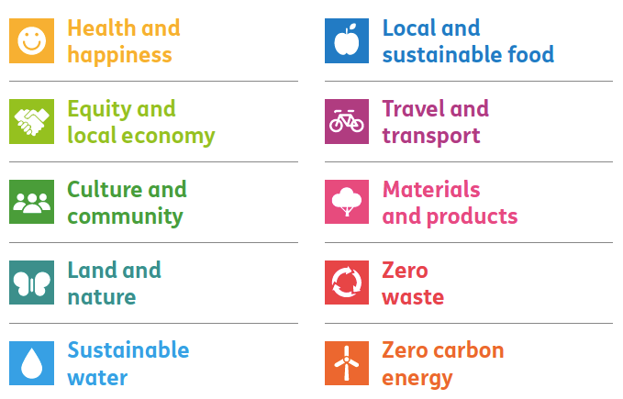
Bioregional’s 10 principles of One Planet Living
Bioregional Annual Review, 2015 -16

Slide 18
2. Our activities

Slide 19
Expanding, deepening and connecting the Conversation
Expand the Conversation to engage a much wider range of participants, both geographically and demographically
Deepen the Conversation by creating safe spaces where people can explore the mental, social and spiritual dimensions of the change we seek
Connect the Conversation to others doing similar work across the Region

Slide 20
Expanding and deepening
Currently we do monthly Conversations online, recordings are on our Youtube Channel at https://www.youtube.com/watch?v=kiFTZuML-xM
Future plans include
Establish a Kitchen Table Conversations program,
Undertake One Planet Neighbourhood Co-design Charettes
Create a Seeds of a One Planet Region project
Establish a Participatory Urban Futures program
[Perhaps] create One Planet Region Awards

Slide 21
Spin-off projects
Working with the Community Social Planning Council to look at the social justice and employment implications of a One Planet Region
Working with faith organisations to explore the ethical and spiritual dimensions of One Planet Living
Initiating a discussion about an initiative around art, nature and place to engage people in considering these global ecological challenges and possible actions.
An ecological economics group, linked to the Green New Deal, looking at what a local ecological economy would look like

Slide 22
Local Seeds of a One Planet Region
New project under development
Based on ‘Seeds of a Good Anthropocene’
People, groups and organisations that are working locally to take us towards a One Planet Region can register themselves
  Simple keyword check-off will make it easily searchable
  areas of work (issues-focused or systems change-focused)
  approach, services offered, location etc

Slide 23
Help us create a Program of Work
Planning and organising this takes people with time and energy
and of course we need to find some financial support.
So if you would like to be involved in any of these plans
please contact me.
Trevor Hancock
Thancock@uvic.ca

Slide 24
2021 Program
Theme: Seeds of a One Planet Region
We will find and showcase people and organisations who are working to create One Planet living in this region.
We will base this on Bioregional’s 10 One Planet Living principles that underlie One Planet Saanich
Schedule
January – One Planet Saanich
February – we will be inviting folks from Sooke
Future sessions TBC, based on the principles

Slide 25
Resources from past Conversations
Most of the PPTs from past presentations are available on Creatively United’s website
https://creativelyunited.org/one-planet-region/resources/

Slide 26
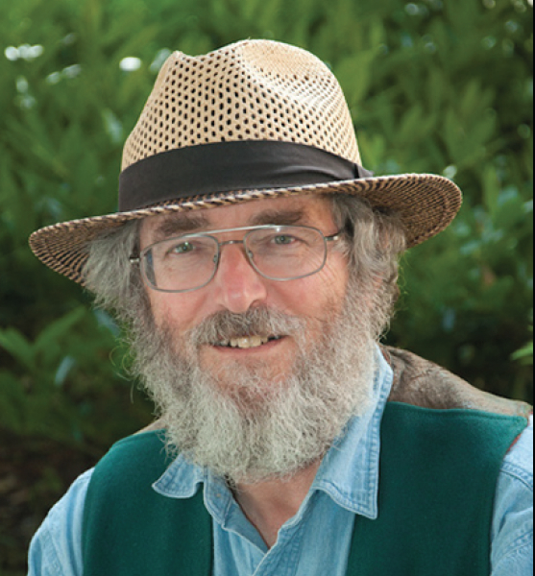
Contact
Dr. Trevor Hancock
Thancock@uvic.ca
Website:
https://trevorhancock.org
https://oneplanetconversations.ca

